Slide 1


INCLUSIVE LANGUAGE
Writing Support Desk
writingsupport@uwindsor.ca

Slide 2

Table of Contents
Introduction:
Some Notes on this Workshop
What is Inclusive Language
Why use Inclusive Language
Guiding Principles
On Messing Up
Disability & Mental Illness
Indigenous Peoples
Gender Identity and Sexual Orientation
Race and Ethnicity
Other Inclusivity Issues
Conclusion
Resources
2

Slide 3
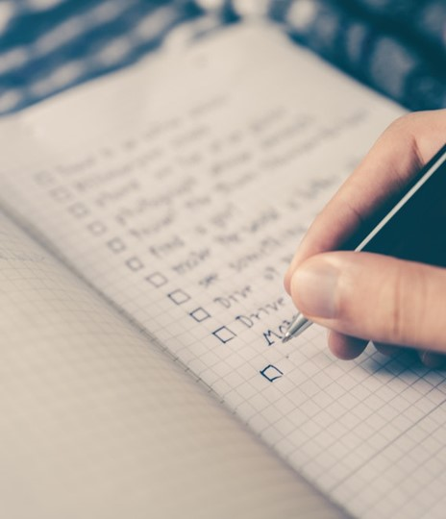
About this Workshop
This Workshop is an overview and not all encompassing.
This Workshop will be outdated: Language changes!
Language is a habit.
Language is the first step in showing care.
Overall, it is important to Focus on the agency of the peoples involved!

Slide 4

WHAT IS INCLUSIVE LANGUAGE?
Language that does not exclude or other individuals or groups
Language that does not perpetuate discrimination or stereotypes
Language that strives for equity & to avoid harm
5

Slide 5


Slide 6
WHY USE INCLUSIVE LANGUAGE?
Language is powerful. It not only describes but can perpetuate and create our realities.
Inclusive language demonstrates respect for others.
UWindsor is committed to equity, diversity, and inclusion.
5

Slide 7
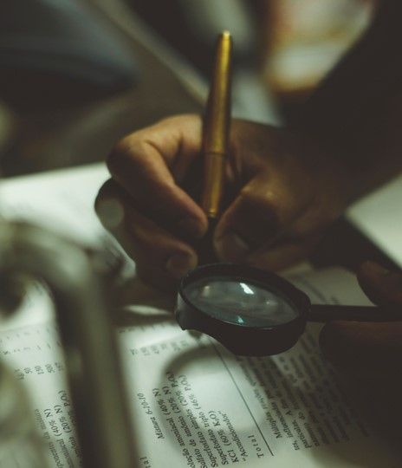
Who determines inclusivity?
Inclusivity is a practice, not a system of rules.
Individuals and their communities determine the language used to describe themselves.
Sometimes, people use "person-first language."
Other times, people use "identity-first language."
(We'll get into more details in the next section)
Focus on the agency of the individual or groups you are interacting with or writing about.

Slide 8
GUIDING PRINCIPLES
RESPECT
RECOGNIZE
REMEMBER
Respect an individual or group’s language preferences to describe themselves and their experiences.
A term that may be appropriate as a member of a group may not be appropriate for use by someone who is not in that group.
These preferences may vary between individuals within groups and communities.
Groups of people are diverse in their experiences. Avoid describing people or experiences as monolithic.
RE-LEARN
Language is constantly changing, so be open to learning new inclusive language standards.

Slide 9
GENERAL INCLUSIVITY TIPS
BE INCLUSIVE
BE CURRENT
BE RELEVANT
Do not assume that your audience has the same background or experiences as you.
Seek to use the most current language and information.
Don’t focus on a person’s race, ethnicity, religion or spiritual beliefs, disability, sexuality, or gender identity if these are not relevant to your writing.
Recognize and respect the diversity of your audience
If you aren’t sure, do some research and find out
This does not mean erasing these aspects of someone’s identity, but consider if there is a need to mention these identifiers.

Slide 10
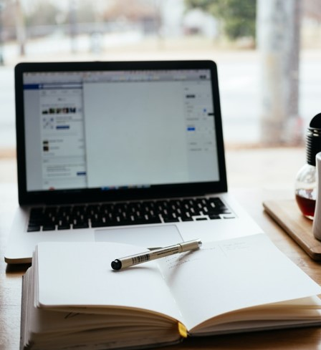
Using Older Source Material
You may come across older texts that use outdated or inappropriate terms and language conventions in your research.
When using these sources, ask yourself if the problematic term(s) are relevant or necessary to your analysis. If not, omit them.
Sources that use outdated generalizations (e.g., 'Oriental") should be refined and specified in your writing.
Remember, your works should always subscribe the guidelines and rules of the most up-to-date style guide used by your discipline.

Slide 11

On Making a Mistake
Mistakes happen. However, there are some good practices that can help you manage the situation with respect:
If you make a mistake and realize it, just quickly say "sorry," followed by the proper term and continue the conversation.
If you mess up and someone tells you after. Thank them, apologize, and try to fix it going forward.
If you continue to make the same mistakes, try getting used to the new words through practicing usage.
We all mess up!

Slide 12
Indigenous Peoples
Disability & Mental Illnesses
Gender Identity & Sexual Orientation
Race & Ethnicity
Other Inclusivity Issues

Slide 13
Indigenous Peoples
Disability & Mental Illnesses
Gender Identity & Sexual Orientation
Race & Ethnicity
Other Inclusivity Issues

Slide 14

Disability and Mental Illnesses
Inclusive language aims to reduce ableist language from everyday speech.
What is Ableism?
A belief system that sees persons with disabilities as "less worthy of respect and consideration, less able to contribute and participate, or of less inherent value than others."
Can be conscious or unconscious.
Can be systemic.
"can limit opportunities of persons with disabilities and reduce their inclusion in the life of their communities."
Definition https://www.ohrc.on.ca/en/policy-ableism-and-discrimination-based-disability/2-what-disability

Slide 15
PERSON-FIRST VS. IDENTITY-FIRST LANGUAGE
PERSON-FIRST LANGUAGE
a person with epilepsy
a person with a learning disability
a person with diabetes
a person with schizophrenia
Different individuals, groups, and communities may have different preferences for person-first vs. identity-first language
Person-first language emphasizes the person before the disability or chronic condition
Some suggest that this type of language separates the person from the disability or implies that disability is negative

Slide 16
PERSON-FIRST VS. IDENTITY-FIRST LANGUAGE
Identity-first language forefronts the disability, often as an act of reclamation or personal/cultural pride
Individuals within communities may vary in their preference for identity-first vs. person-first (ex. in the autism community)
Always check with individuals if possible for preferences
APA 7 allows both as appropriate
IDENTITY-FIRST LANGUAGE
an amputee
a blind person
a Deaf person
an autistic person

Slide 17
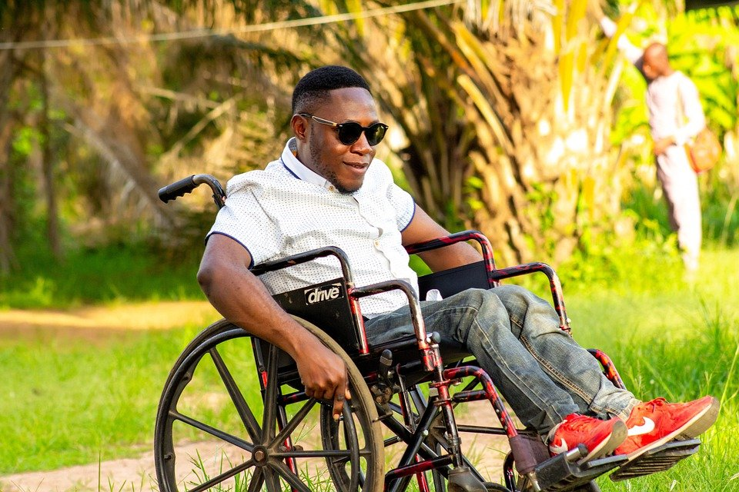
LANGUAGE & DISABILITY
Not all disabilities may be visible
Avoid tropes implying that people with disabilities are ‘inspiring’ or exceptional because of their disabilities
Ensure that content is accessible by following the Accessibility for Ontarians with Disabilities Act (AODA), including alt text for images and captioning for audio.

Slide 18

LANGUAGE & DISABILITY
Avoid using common phrases that imply that disability is a problem
Barriers to accessibility are the problem, not disabilities
crippled
AVOID
suffers from MS
is confined to a wheelchair
handicapped parking
able-bodied
USE
uses an assistive device
has MS
accessible parking
non-disabled
has a physical disability

Slide 19
LANGUAGE & DISABILITY
Avoid condescending and offensive terms that have been imposed on the disability community.
These terms often imply that having a disability is negative and place the onus for accessibility on the person, not the environment.
AVOID
special/special needs
differently abled/challenged
defect/deformity
normal/abnormal

Slide 20
LANGUAGE & DISABILITY
Many commonly used words and expressions are ableist in nature
These terms are often used metaphorically, but many originate in the oppressive treatment of people with disabilities
These terms can unknowingly perpetuate stigmas
AVOID
that’s so lame
that’s crazy
this is stupid/idiotic/dumb
insanely talented
USE
that’s unexpected/surprising
that’s boring/uncool
this is frustrating/pointless/boring
extremely/exceptionally talented

Slide 21
LANGUAGE PREFERENCES
Use language preferred by groups and individuals you're communicating with.
While discussing a “visual impairment” may be appropriate, some in the Deaf community consider “hearing impaired” to be offensive.
Note that one person preferring a term does not make that term appropriate or preferable to a whole group.
AVOID
hearing impaired
victim
USE
survivor
Deaf/hard-of-hearing

Slide 22
Indigenous Peoples
Disability
Gender Identity
Sexuality
Race & Ethnicity

Slide 23
INDIGENOUS PEOPLES
Land Acknowledgements
Indigenous Peoples within Canada
Recognize the traditional territories of Indigenous Peoples
First Nations, Inuit, and Métis
Avoid using “Canada’s Indigenous Peoples”
Indigenous Peoples (collectively discussing Indigenous Peoples) vs. Indigenous people (more than one Indigenous person)
The University of Windsor sits on the traditional territory of the Three Fires Confederacy of First Nations, comprised of the Ojibwa, the Odawa, and the Potawatomi.
Acknowledge that settlers are on Indigenous lands
Nations are distinct. Reference the specific Nation, community, or band when possible.

Slide 24
INDIGENOUS PEOPLES
Terminology
Common Misconceptions
To collectively describe First Nations, Inuit, and Métis in Canada, use Indigenous Peoples.
Do not confuse Inuit and Inuk. The singular of Inuit is Inuk. Saying Inuit People is redundant (Inuit means people). Their language is Inuktitut. Only use the term Inuit to refer to this group of Indigenous Peoples within Canada and avoid older & offensive terms.
Aboriginal is also generally an appropriate term, but Indigenous is used more universally.
Capitalize Indigenous and Aboriginal just as you would capitalize English or French.
Avoid using ‘Native American’ or ‘Indian’.
Do not assume that all Indigenous individuals in the LGBTQ2SIA+ community are Two-Spirit. Two-Spirit individuals may also hold other identities.

Slide 25
INDIGENOUS PEOPLES
Avoid appropriating cultural terms from Indigenous communities. These have specific meanings that should not be used out of context.
we’ll have a pow-wow
at the bottom of the totem pole
X is my spirit animal
I found my tribe
AVOID
USE
at the top/bottom of the hierarchy
we’ll have a meeting
I identify with X
I found my community

Slide 26
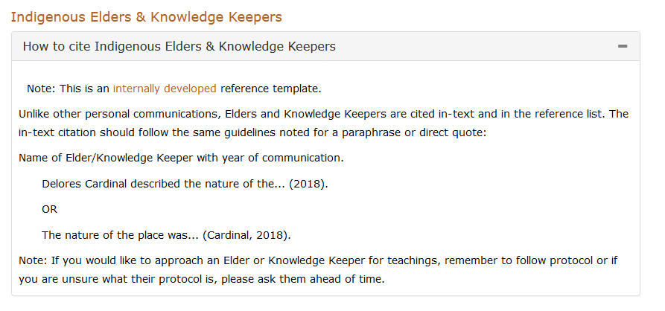
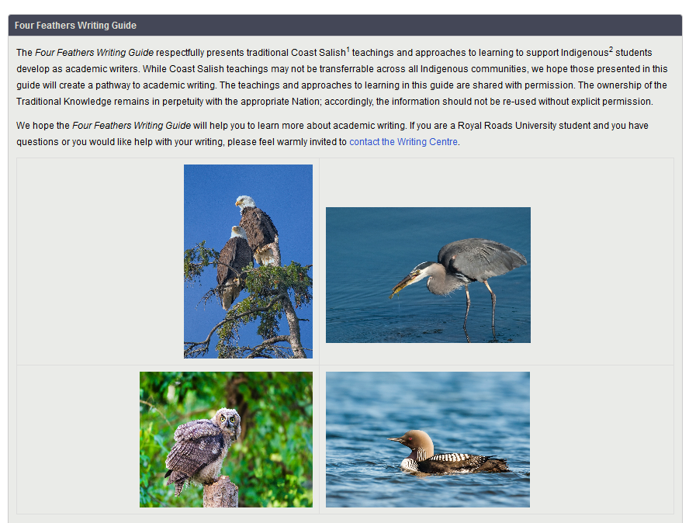
INDIGENOUS PEOPLES
NorQuest College has produced a guide on citing Indigenous Elders and Oral Traditions in MLA and APA forms
Always learn and follow protocol when contacting and citing Indigenous Elders and Knowledge Keepers
The Four Feathers Writing Guide from Royal Roads University incorporates Coast Salish teachings into academic writing development
5

Slide 27
Indigenous Peoples
Disability
Gender Identity & Sexual Orientation
Sexuality
Race & Ethnicity

Slide 28
LANGUAGE & GENDER
Much commonly used language is gendered, even if we do not notice
Using gendered terms and language can exclude people
Use gender-neutral terminology to be inclusive
mankind
spokesman
ladies and gentlemen
guys
AVOID
USE
spokesperson
humankind
distinguished guests
people, friends, folks, all

Slide 29
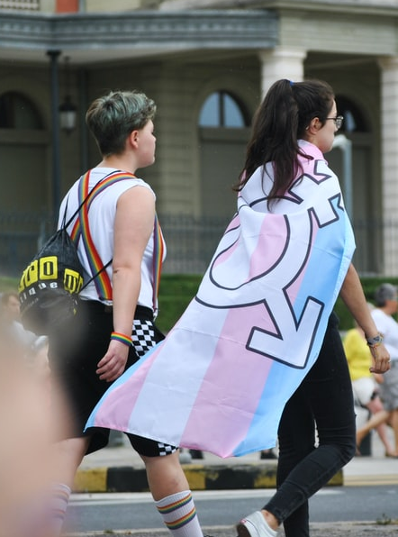
GENDER IDENTITY
Is distinct from sexual orientation
Is each individual’s sense of their own gender
Exists on a continuum, not as a binary of male/female
Language should be inclusive of cis, trans, non-binary, Two-Spirit, gender-non-conforming, and all gender-expansive people.

Slide 30
PRONOUNS, TITLES, & GENDER
Singular “they” is grammatically correct when the gender of the subject is unknown or the subject uses they/them pronouns
Pluralizing can also help keep phrases gender neutral
Dr. is a gender-neutral honourific for anyone with a doctorate
Do not assume someone’s gender/pronouns/honourific
his/her
each student should choose his classes
Ma’am, Sir, Mr., Mrs., Ms. (when gender is assumed/unknown)
AVOID
USE
each student should choose their classes OR students should choose their classes
their
Dr. (when applicable) or ask for the appropriate honourific

Slide 31
PRONOUNS, TITLES, & GENDER
Always use the correct pronouns identified by an individual. Be aware that they may use neo-pronouns (ex. xe/xem/xyr) or gender-neutral pronouns (they/them)
In research, avoid providing only binary options for participants to declare gender or pronouns
Select gender: male or female
Select pronouns: he/him, she/her, or they/them
AVOID
USE
Write in your pronouns
Write in your gender

Slide 32
TRANS IS AN ADJECTIVE
Using trans as a noun can be dehumanizing (she’s a trans)
People are transgender, not transgendered (trans is not a verb)
Trans is an adjective that modifies the noun (for example woman, man, person), not a compound word
he’s a trans/transgender
they are transgendered
she is a transwoman/trans-woman
AVOID
USE
they are a transgender person
he’s a transgender man / trans man
she is a trans woman

Slide 33

SEXUAL ORIENTATION
Is distinct from gender identity
Describes patterns of romantic or sexual attraction

Slide 34
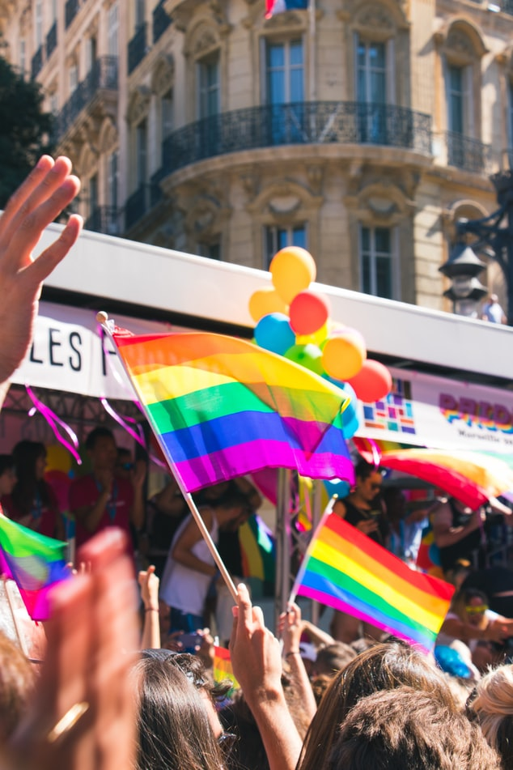
TERMINOLOGY
Often, an initialization will be used to encompass the rainbow community, but these can differ.
LGBT has been expanded to be more inclusive. Sometimes shortened versions are used for practicality.
A + or * symbol may be added to acknowledge orientations and identities outside the letters included.
These initializations include a range of both sexual orientations AND gender identities.

Slide 35
LGBTQ2SIA+
lesbian
gay
bisexual
transgender
queer & questioning
Two-Spirit
intersex
asexual
+

Slide 36
TERMINOLOGY
While the word queer has been reclaimed by many, some do not identify with this term, especially when used by those outside the community
Gay should not be used as a blanket term for all LGBTQ2SIA+ folks
Gay should not be used to mean uncool, bad, or uninteresting
gay marriage
lifestyle/preference
the gay community (unless only discussing gay people)
AVOID
USE
sexual orientation
marriage
the LGBTQ2SIA+ community/ the rainbow community

Slide 37
Indigenous Peoples
Disability & Mental Illnesses
Gender Identity & Sexual Orientation
Race & Ethnicity
Other Inclusivity Issues

Slide 38
RACE & LANGUAGE
Race is a social construct and is mediated by language
Always identify individuals and groups with the terms they choose for themselves
Black and African American or African Canadian are not synonymous
visible minority
mixed-race people
AVOID
Oriental
USE
multiracial people
racialized person/community
Asian (or specific nationality)
Notes:
National Association of Black Journalists recommends against using mixed-race or mixed, but some people choose this term for themselves

Slide 39
RACE & LANGUAGE
Some words have racist origins or call back to racial injustices
These terms are gradually falling out of use and being replaced
grandfather clause
master bedroom
AVOID
long time no see
no can do
peanut gallery
sold down the river
uppity
USE
primary bedroom
legacy clause
haven't seen you in a while
I cannot do X
critics
snobbish
betrayed

Slide 40
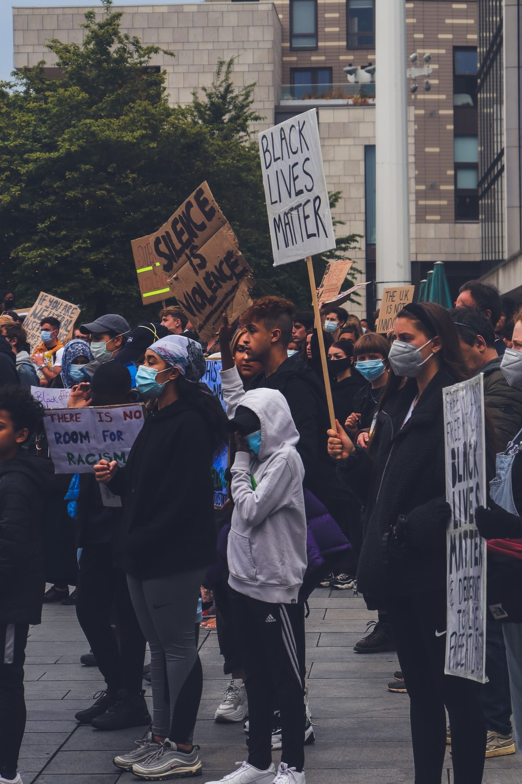
RACE & CAPITALIZATION
Capitalize proper names of peoples, places, communities, and ethnicities (Arab, Cree, Latine, Jewish, Black, etc.)
Lower-case black is a colour, not an adjective to describe a person or community. Capitalize Black when it describes people, cultures, and communities of African diaspora.
There is debate in style guides and newspapers about whether to capitalize white as it refers to a skin colour, not necessarily a culture or community.
APA style recommends capitalizing both Black and White when they refer to people. The Associated Press does not capitalize white but does capitalize Black.

Slide 41
Other Inclusivity Issues

Slide 42
Some Other Areas of Language to Consider
This Presentation cannot cover each area in depth, and there are many other issues with language use to consider in terms of inclusivity.
Avoid Ageist Phrases (e.g., geezer,” “elderly,” “senior,” “senile,” “old school,” etc.)
Many who have experienced sexual assault prefer to be referred to as survivors rather than victims.
When discussing suicide, the Government of Canada suggests using person-first language (Person who has died by suicide, Person thinking about suicide, or People who have experienced a suicide attempt) and avoiding problematic language like suicide victim, suicidal, contemplators, attempters. (https://www.canada.ca/en/public-health/services/publications/healthy-living/language-matters-safe-communication-suicide-prevention.html)
Avoid sizeism and body shaming.
Generally, avoid discussing someone as a “victim” as many people prefer “survivor”.

Slide 43




Style Guides
If you are unsure of specifics related to your discipline, each style guide has notes related to their discipline.

Slide 44
Chicago Style Guide
Chicago recommends the Conscious Style Guide as a place to explore if you are unsure of terms. This website outlines what might be relevant to understand related to certain areas of language.
The Chicago Style Guide also outlines some point regarding bias-free language alongside some techniques to ensure gender neutrality:
Biased language that is not central to the meaning of the work distracts many readers and makes the work less credible to them.
Careful writers avoid language that reasonable readers might find offensive or distracting—unless the biased language is central to the meaning of the writing.
Avoid irrelevant references to personal characteristics.
(5.251-5.260 in the Chicago Style Guide)

Slide 45
APA Style Guide
APA's Inclusive Language Guidelines provide outlines and suggestions for language to remove bias and ensure the connection to equity, diversity, and inclusion within writing.
Their guide has phrases, suggestions related to outdated phrases, definitions related to inclusion, and more on the topic of Inclusive Language.
If you are unsure of a term, trying searching for it in the webpage below and following APA's guidelines.
https://www.apa.org/about/apa/equity-diversity-inclusion/language-guidelines

Slide 46
MLA Style Guide
MLA offers several tips on how to write using inclusive language
Ensure identity markers are relevant to your point.
Be specific and avoid generalizations.
Respect community terms.
Use consistent capitalization throughout the work.
Avoid quotation marks or italicization of identity terms to avoid weaking meaning.
Avoid gender if not central to your statement.
Avoid adjectives that suggest negativity in relation to a person or groups experience.
If quoting an offensive term, use the first letter and a dash in lieu of the complete spelling.
https://guides.lndlibrary.org/c.php?g=1190811&p=8784900

Slide 47
IEEE Style Guide
IEEE requires language that comply with its Nondiscrimination policy, specifically noting a specific resolution from its Standard Board
"IEEE standards (including recommended practices and guides) shall be written in such a way as to unambiguously communicate the technical necessities, preferences, and options of the standard to best enable market adoption, conformity assessment, interoperability, and other technical aspirations of the developing standards committee. IEEE standards should be written in such a way as to avoid non-inclusive and insensitive terminology (see IEEE Policy 9.27) and other deprecated terminology (see Clause 10 of the IEEE SA Style Manual) except when required by safety, legal, regulatory, and other similar considerations. Terms such as master/slave, blacklist, and whitelist should be avoided."

Slide 48


Slide 49
REMEMBER
Be sure to prioritize respect and inclusivity
Groups and communities are diverse and individuals may have varying language preferences
Always use the language requested by the particular individual or group
Language is always changing, so be open to learning and growing

Slide 50
GUIDING PRINCIPLES
RESPECT
RECOGNIZE
REMEMBER
Respect an individual or group’s language preferences to describe themselves and their experiences.
A term that may be appropriate as a member of a group may not be appropriate for use by someone who is not in that group.
These preferences may vary between individuals within groups and communities.
Groups of people are diverse in their experiences. Avoid describing people or experiences as monolithic.
RE-LEARN
Language is constantly changing, so be open to learning new inclusive language standards.

Slide 51
UWINDSOR RESOURCES
Office of Human Rights, Equity, and Accessibility (OHREA)
https://www.uwindsor.ca/ohrea/
UWindsor Indigenous Resources
https://www.uwindsor.ca/ctl/513/indigenous-resources
UWindsor LGBTQ+ Community
https://www.uwindsor.ca/lgbtq/
Student Accessibility Services
https://www.uwindsor.ca/studentaccessibility/
UWindsor Challenging Anti-Black Racism https://www.uwindsor.ca/antiblackracism/

Slide 52
ADDITIONAL RESOURCES
https://www.queensu.ca/styleguide/inclusivelanguage
https://www2.gov.bc.ca/gov/content/home/accessible-government/toolkit/audience-diversity/inclusive-language-and-terms
http://www.humber.ca/makingaccessiblemedia/modules/01/transript/Inclusive_Language_Guide_Aug2017.pdf
https://www.dal.ca/dept/communicationsandmarketing/tools-and-resources/editorial_style_guide/inclusive_language.html
https://apastyle.apa.org/style-grammar-guidelines/bias-free-language/disability

Slide 53
QUESTIONS?
Remember, this slideshow and many others are available to download via the Writing Support Brightspace page.
Students can self-enroll as 'learners' either by selecting 'Discover' from the Brightspace landing page and clicking 'Enroll' on the Writing Support organization.

